Slide 1
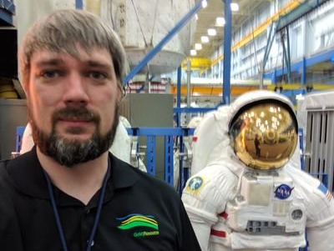
for Subsurface Hackathon in Paris return 'Seismic Shotgather Interpreter'
Teamname = 'Classy'
Tmembers = ['Yuriy Ivanov', 'Anna Lim', 'Princy Ndong', 'Song Hou', 'Justin Gosses']
Houston,
We have a problem!

Slide 2
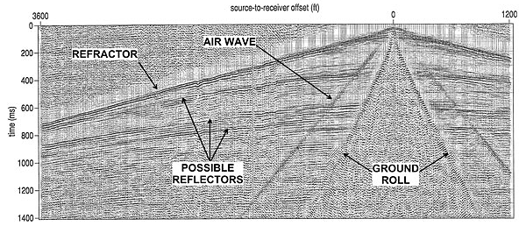
# Problem
?
?
?
?
Notes:
Time consuming
Manual adjustment
Learning does not accumulate

Slide 3
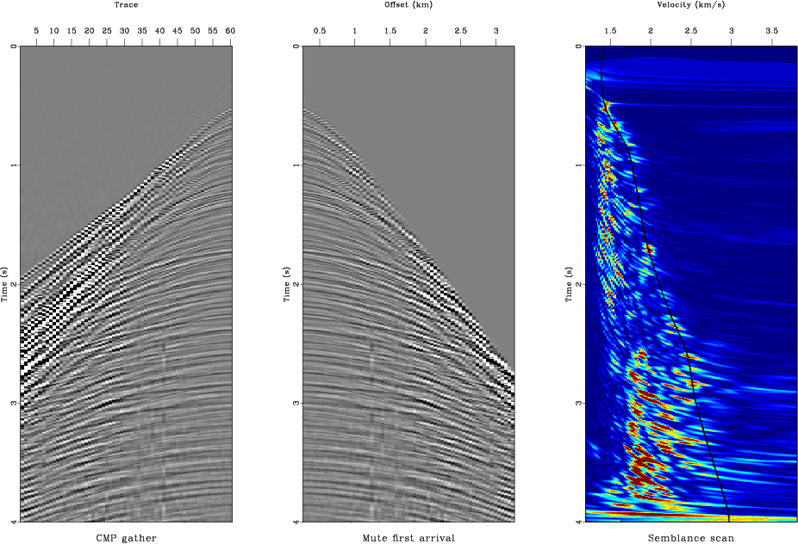
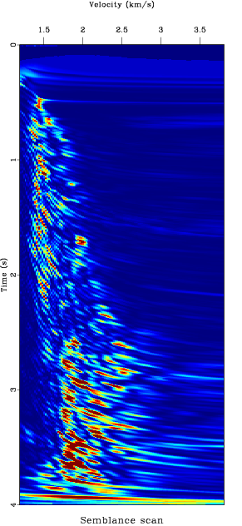
# Approach
In [1]:
Radon
Transform
Project
events

Slide 4
# Workflow and Tools
Generate training set # with labels
Train a classifier using SVM
Generate test set # without labels
Classify data
Draw interpreted lines
Notes:
Support Vector Machines

Slide 5




Thank you!

